Slide 1
Call Center Performance Optimization:
A Monte Carlo Approach
CSE718
Fall-2023
Group 11
Group Members-
Name | ID
Nazifa Khanom | 22166009
Mashfurah Afiat | 23366039
Tahmid Zarif Ul Hoq Sayor | 23266015
Alvin Rahul Hore | 23166005
ST- Mehnaz Ara Fazal
RA- Humaion Kabir Mehedi
Course Instructor:
Annajiat Alim Rasel
Senior Lecturer,Department of Computer Science and Engineering,BRAC University

Slide 2
INTRODUCTION
In the ever-evolving realm of customer service, the imperative to optimize call center performance remains paramount for organizations committed to refining both customer satisfaction and operational efficiency. Among the diverse methodologies available, the utilization of Monte Carlo simulation emerges as a notably potent and forward-thinking approach for scrutinizing and enhancing call center operations. In this paper, we identify how different operational scenarios in a call centre affect various KPIs (key performance indicators) and used random forest to determine the significance of features. By aggregating predictions from multiple decision trees, the model can effectively identify patterns, relationships, and key factors influencing call center performance.

Slide 3
LITERATURE SURVEY
A subfield of applied mathematics and operations research called queueing theory examines queues, or waiting lines, in a variety of systems. It offers a framework in mathematics for evaluating and improving the operation of systems in which elements, such as clients, tasks, or data packets, are waiting in queues for services. In a paper, the application of queueing theory to optimize call center performance was discussed. It highlights the theoretical foundation of queueing theory and its recent applications in various fields. The challenges of managing call centers, with their complex stochastic processes, are outlined. The main focus is on determining the optimal number of operators in a call center to balance service quality and operating costs.

Slide 4
Another paper provides a comprehensive overview of methods and techniques crucial and begins with a concise introduction to machine learning, summarizing supervised learning methods, and delving into the significant area of Reinforcement Learning (RL). The discussion emphasizes the remarkable growth in RL and its various sub-fields.
It concludes by highlighting applications of RL in call center operations and framing the significance of the dissertation's contributions

Slide 5
Furthermore,Discrete Event Simulation (DES) is a modeling and simulation technique used to analyze and study the dynamic behavior of complex systems over time. In a discrete event simulation, the focus is on the changes in the system at specific points in time when events occur, rather than modeling the system continuously. Regarding DES, a paper highlights the challenges faced by call center managers in balancing operating costs and service quality, emphasizing the need for effective decision support models, particularly using DES.
The model simulates call center operations, considering factors like inter-arrival times and abandonment rates. The summary emphasizes the importance of DES in addressing the complexities of call center management.

Slide 6
We used the integration of Monte Carlo simulation in call center operations because it offers a multifaceted approach to analyzing and optimizing performance. By adeptly modeling the uncertainties and variability inherent in call center dynamics, this simulation technique provides a comprehensive understanding of system behavior under diverse scenarios.
Furthermore, this approach excels in risk assessment, allowing for the identification and quantification of potential outcomes and associated probabilities.
In conjunction with a Random Forest model, sensitivity analysis becomes possible, revealing the significance of different operational features. This data-driven decision-making process ensures that efforts are focused on the most influential aspects of call center operations.

Slide 7
COLLECTED DATA
The data used was collected from Data.world
Call Data - containing information of each individual call - a total of 1524 calls
Hierarchy - agent information
Call Result - metrics and formulas

Slide 8
PROPOSED METHODOLOGY
Objective Overview: Explore call center intricacies: call rates, handling times, and agent efficiency.
Data Utilization:Employ a comprehensive dataset for empirical foundations.
Simulation Approach: Implement Monte Carlo method Incorporate real-world data for stochastic elements.
Monte Carlo Exponential Distribution: Utilize the exponential distribution to model randomness. Align with observed variability in call arrival patterns.
Agent Workforce Simulation: Simulate a fixed number of call-receiving agents Reflect the actual workforce available for handling calls.
Queuing Dynamics: Address challenges when agents are occupied. Introduce a queuing mechanism for caller

Slide 9
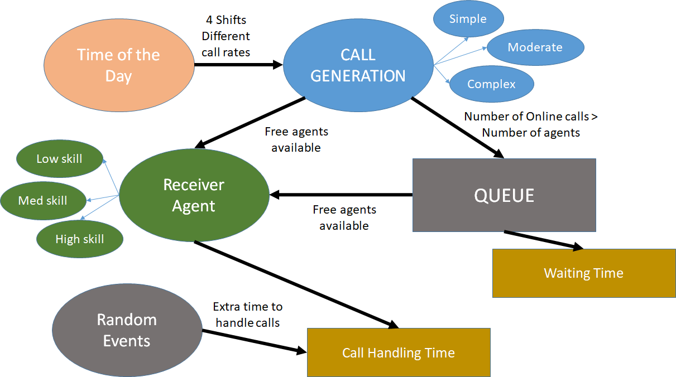
PROPOSED METHODOLOGY

Slide 10
PROPOSED METHODOLOGY
Key Performance Indicators:
Waiting time
Queue length
Scenario-based Simulations:
Various agent skill distribution
Complex calls extreme cases
Highly probable random events
Agent Count Optimization:
Variable call receiver agent count throughout the day depending on call rates
Random Forest Algorithm
Feature impact evaluation

Slide 11

PROPOSED METHODOLOGY
Simulation environment:
Python - Simpy

Slide 12
THANK YOU

